Slide 1
Statistical Learning: Dataset analysis project
Presentation by
Gotti Daniele – 1079011
Mazzoleni Gabriele - 1079514

Slide 2
Selected dataset - Food Delivery Time Prediction
Reference link: https://www.kaggle.com/datasets/denkuznetz/food-delivery-time-prediction
This dataset is designed for predicting food delivery times based on various influencing factors such as distance, weather, traffic conditions, and time of day.
This dataset contains simulated data to predict food delivery times based on various real-world factors.

Slide 3
Dataset variables
Order_ID: Unique identifier for each order (unused in this analysis, as it is irrelevant for regression models).
Distance_km: The delivery distance in kilometers.
Weather: Weather conditions during the delivery, including Clear, Rainy, Snowy, Foggy, and Windy.
Traffic_Level: Traffic conditions categorized as Low, Medium, or High.
Time_of_Day: The time when the delivery took place, categorized as Morning, Afternoon, Evening, or Night.
Vehicle_Type: Type of vehicle used for delivery, including Bike, Scooter, and Car.
Preparation_Time_min: The time required to prepare the order, measured in minutes.
Courier_Experience_yrs: Experience of the courier in years.
Delivery_Time_min: The total delivery time in minutes (target variable).

Slide 4
Objective of the analysis
The objective of this analysis is the creation of a model that can predict the necessary time for food delivery given a set of circumstance data.
Such model may then be implemented in software applications for delivery services, to inform clients of expected wait times even before the order has been completed.

Slide 5
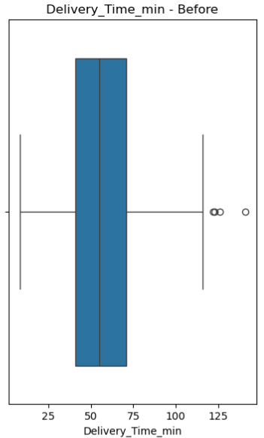
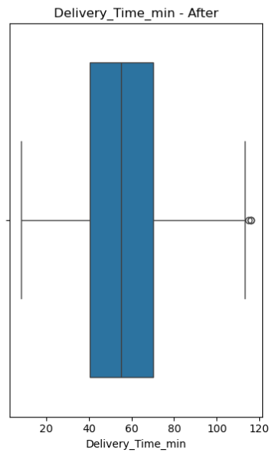
Preliminary analysis
We begin our analysis by “cleaning” the dataset, specifically removing rows containing null values that would cause errors during further computations; this operation reduced the number of total rows from the initial 1000 to 883.
We then remove any outliers that may distort the model, luckily, only four rows are classified as outliers at this point.

Slide 6
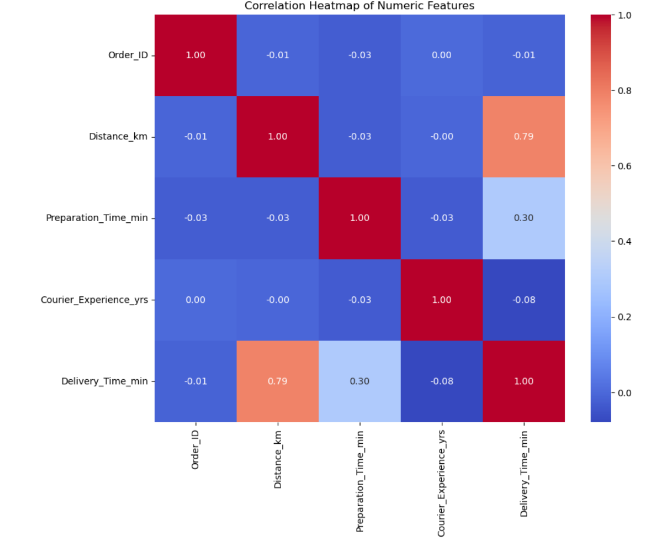
Evaluating correlation
Before building regression models, we assess the quality of the dataset by analyzing the correlation between variables through the construction of a correlation matrix.
In our case, some variables show a clear linear relationship with delivery time, indicating their potential importance in the regression model. Additionally, the predictors are not highly correlated with each other, suggesting that the dataset is suitable for linear regression and that multicollinearity is not a concern.

Slide 7
Simple linear regression
The three numerical variables (Distance_km, Preparation_Time_min, Courier_Experience_yrs) are selected, and the relationship between each of them and the response variable Delivery_Time_min is analyzed individually.
The resulting models are mostly similar, all three variables individually have a high importance (as discernible by their low P-value); the travel distance generates the best model out of the three, while the preparation time and courier experience, while having an impact on the delivery time, seem to not be enough by themselves to predict delivery time.

Slide 8
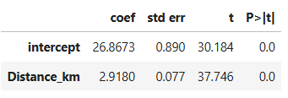
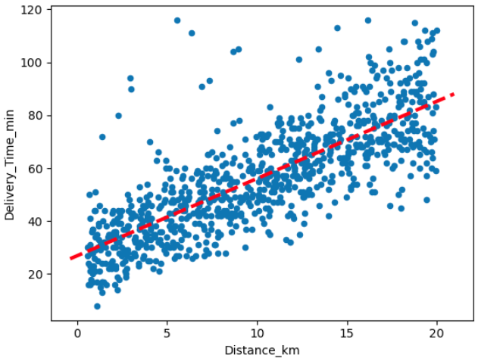
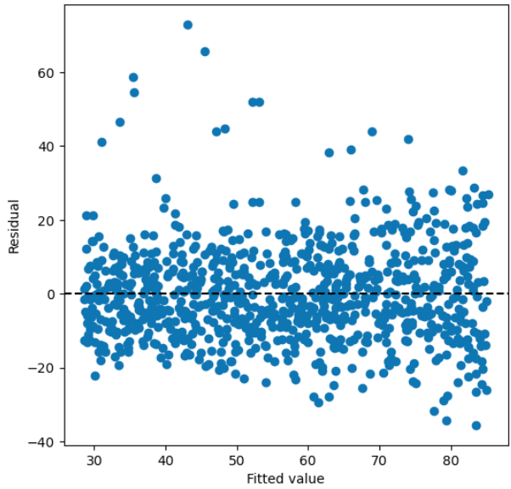
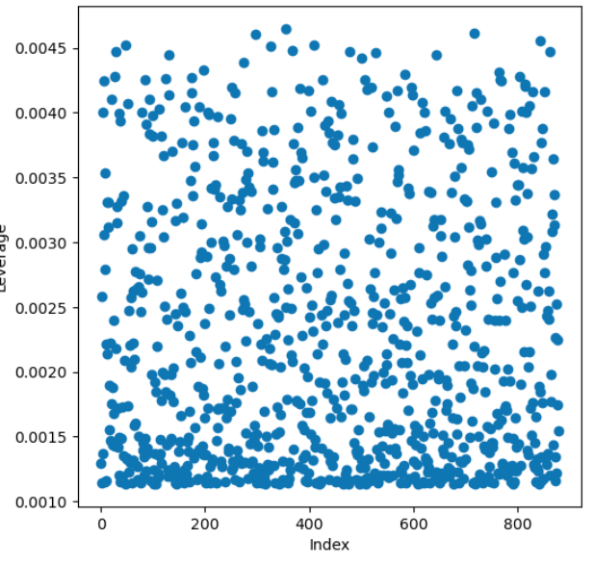
First case: modelling Distance_km

Slide 9
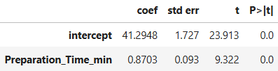
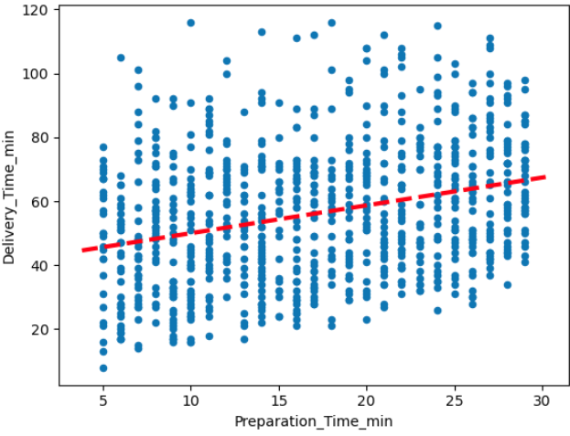
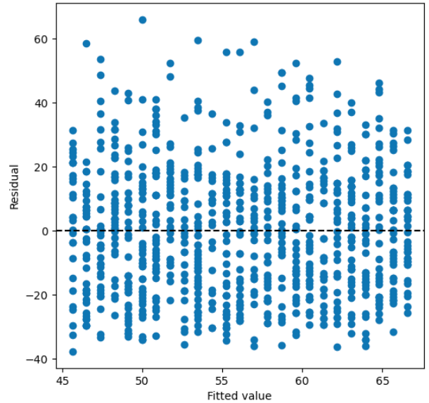
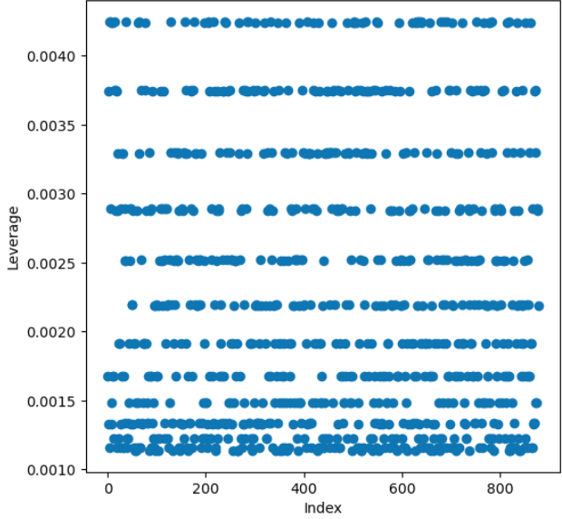
Second case: modelling Preparation_Time_min

Slide 10
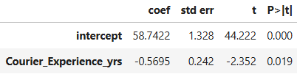
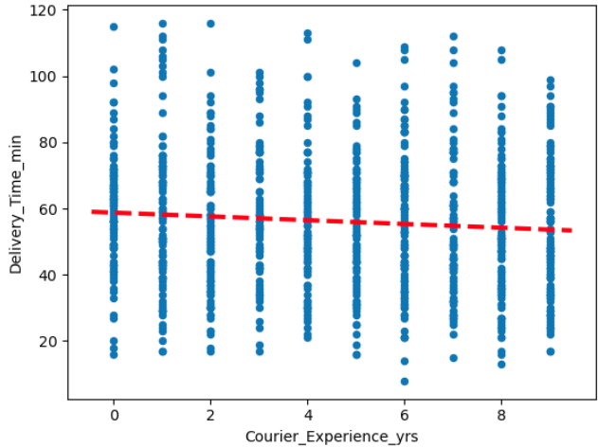
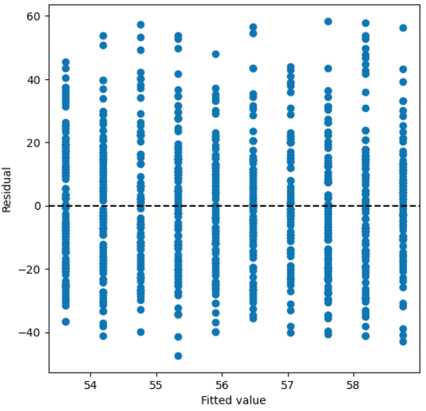
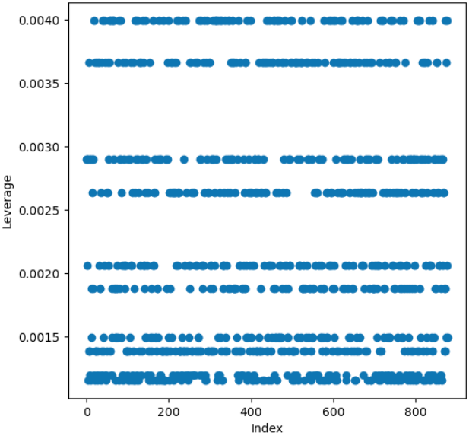
Third case: modelling Courier_Experience_yrs

Slide 11
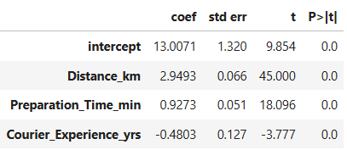
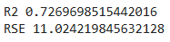
Multiple linear regression - using numerical predictors only
The results of the linear regression model indicate that distance, preparation time, and courier experience significantly influence food delivery time (p-values = 0).
The linear regression model explains approximately 73% of the variance in food delivery time, indicating a strong fit. The residual standard error (RSE) is 11 minutes, suggesting a moderate prediction error given the likely range of delivery times. Overall, the model performs well.

Slide 12
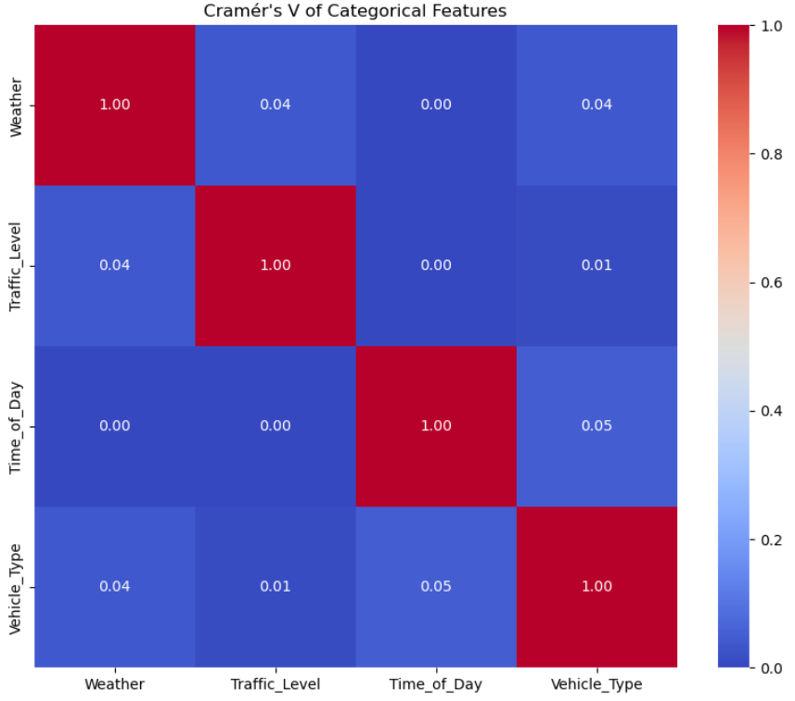
Multiple linear regression - evaluation of categorical regressors
Before creating the new model, we verify that the categorical variables are not strongly correlated with each other, ensuring that each one contributes useful information to the model. Since the variables are not numerical, we cannot use a standard correlation matrix. Instead, we use Cramér's V, a statistical measure of association between two categorical variables, which ranges from 0 (no association) to 1 (perfect association).

Slide 13
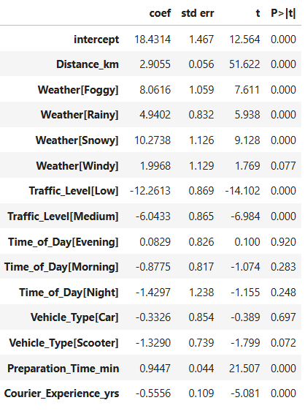
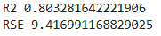
Multiple linear regression - full model evaluation
Distance_km has a strong and significant positive effect on delivery time.
Adverse weather conditions like Foggy, Rainy, and Snowy significantly increase delivery time, compared to Clear weather.
Traffic_Level[Low] and Medium significantly reduce delivery time compared to High traffic, which is the baseline.
Different times of the day (Morning, Evening, Night) do not show statistically significant differences (p-values > 0.05) from the baseline (Afternoon).
Similarly, neither Car nor Scooter types show significant differences (p-values > 0.05) from the baseline vehicle (Bike), suggesting that vehicle type may not strongly influence delivery time in this model.
Preparation_Time_min significantly increases delivery time, as expected.
Courier_Experience_yrs is negatively associated with delivery time, indicating that more experienced couriers tend to deliver faster.

Slide 14
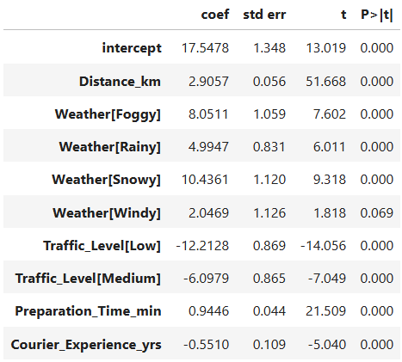
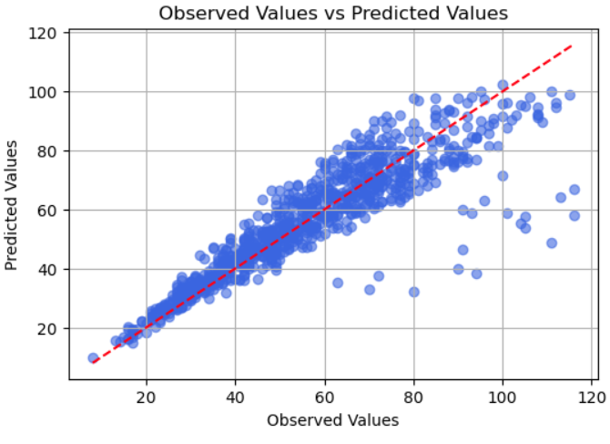
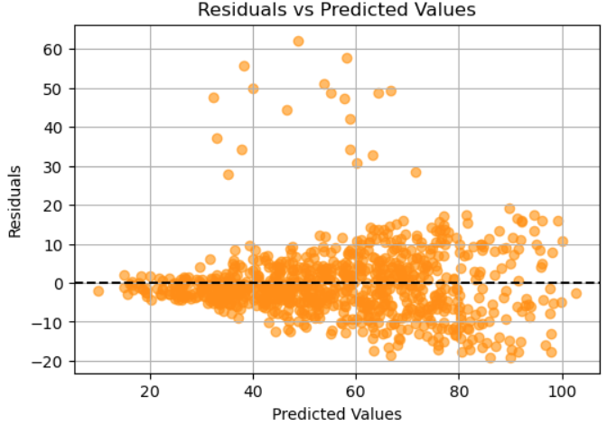
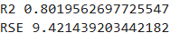
Multiple linear regression - refined model
We choose to remove Vehicle_Type and Time_of_day, as they are the least statistically significant, with high p-values.

Slide 15
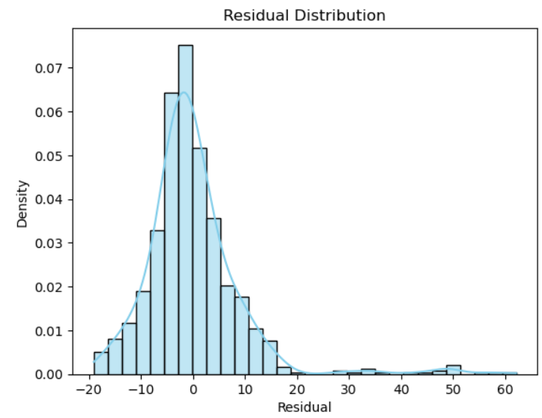
Multiple linear regression - residual evaluation
To improve the robustness of the regression model, we removed outliers based on the distribution of residuals from an initial OLS fit. Residuals follow a normal distribution (as confirmed by the plot on the right), and a threshold based on the standard deviation is applied to identify anomalous observations. Instead of the conventional ±3 standard deviations, we adopted a slightly more restrictive cutoff of ±2.9 standard deviations.
This choice allowed us to remove all significant outliers without discarding a substantial portion of the data.

Slide 16
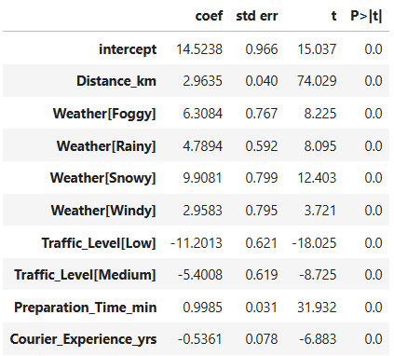
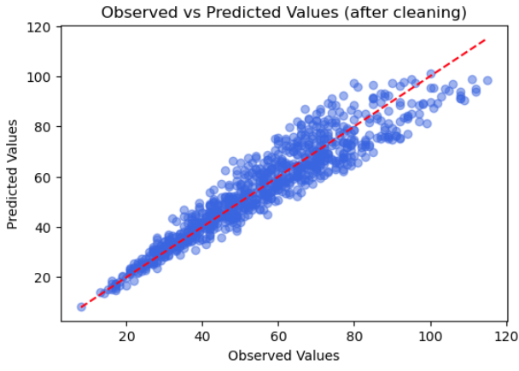
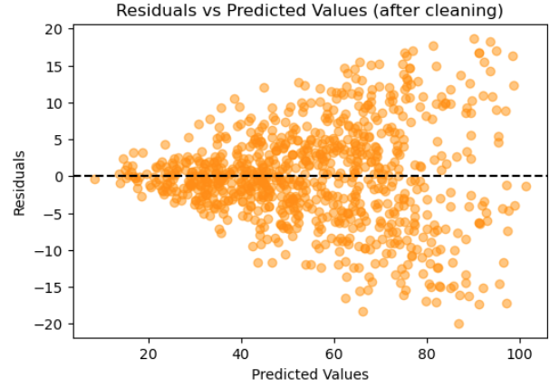
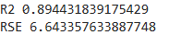
Multiple linear regression - refined model with cleaned data
With the removal of the outliers the R² value has improved by about 10%, nearly reaching 90%. The error in delivery time is now approximately 6-7 minutes.
However, from the Residuals vs Predicted Values plot, we can observe a clear cone-shaped pattern, with residuals starting from 0 and ranging between -20 and +20. This pattern indicates heteroscedasticity, meaning the variance of the residuals increases as the predicted values grow.

Slide 17
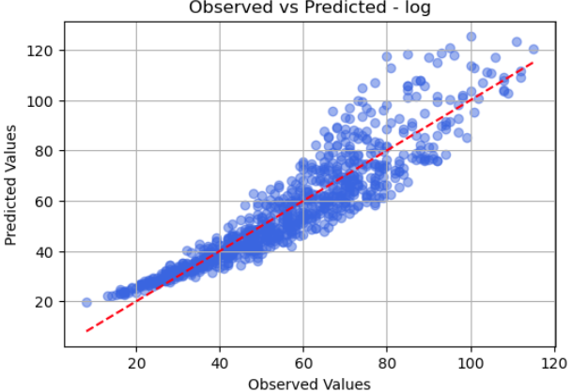
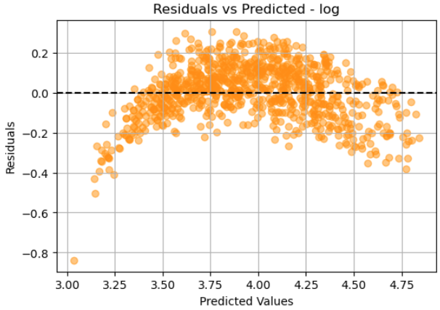
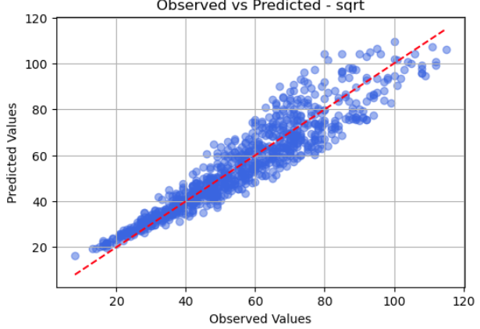
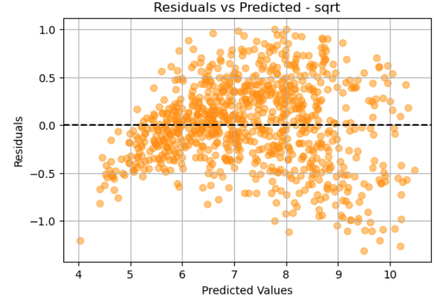
Multiple linear regression - model transformations
After noticing heteroscedasticity in the previous model’s residuals graph, we attempt transformations on the model to try to improve its performance.
The logarithm-transformed model (first row) is slightly worse than the base model, as we can see in the scatterplot.
The square root –transformed model (second row) has a slightly better residual distribution.
Observing the results from the plots, no clear improvement is noticeable. Moreover, the R² values are similar to the original model. Therefore, we prefer to continue our work with the non-transformed model.

Slide 18
Cross validation
By testing the model on a separate validation set, we can detect overfitting and assess real-world performance.
Cross-validation: we split the dataset into a training set Food_train and a validation set Food_valid. We explicitly define the size of the validation set (430 samples), which is exactly half of the total dataset, to ensure a consistent and controlled evaluation.
MSE: 48.8813195529826 RMSE: 6.991517685952214
Leave-one-out cross-validation is more precise but the most expensive in terms of both time and computation, as it requires the model to be trained multiple times, with each iteration leaving out a single data point for validation. Indeed, the results obtained in terms of MSE and RMSE were slightly improved compared to the previous cross-validation.
MSE: 44.70860072334475 RMSE: 6.686449036921223
K-fold cross-validation strikes a balance between the former two: the results obtained are positioned between those from the 50%-data cross-validation and the leave-one-out.
MSE: 45.05819307596635 RMSE: 6.712539986917497

Slide 19
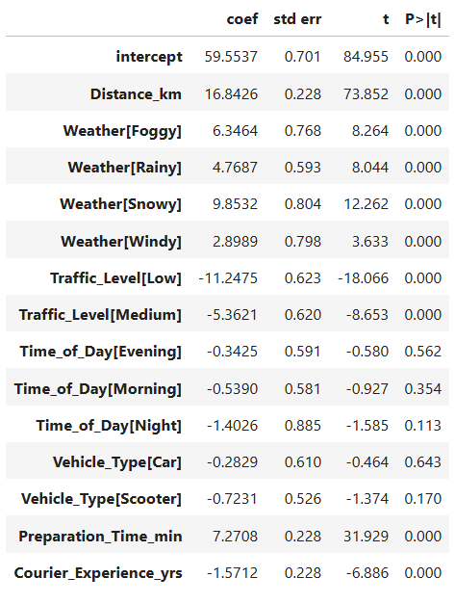
Shrinkage methods
We continue the analysis of the model using shrinkage methods. These methods allow setting the coefficients of variables to zero. To do this, it makes sense to return to a model with all variables. This means adding back the categorical variables Time_of_Day and Vehicle_Type. It is also important to normalize the model, as this ensures all variables are on the same scale.
The shrinkage methods we utilize in this analysis are Ridge and Lasso regression.

Slide 20
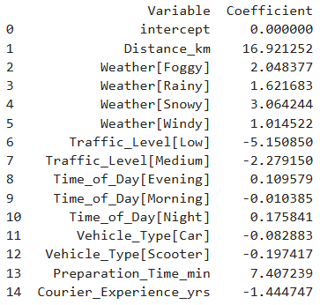
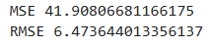
Ridge regression
We begin by splitting the database into train and test sets. Next, we search for the optimal lambda for ridge regression.
Best Ridge lambda: 1.7680381784572086
We evaluate the test set using the lambda found.
From the results, we see that the less significant variables (also observed in previous models and methods) have coefficients very close to zero for ridge regression. This occurs because ridge regression shrinks coefficients of less relevant variables toward zero, improving model generalization. We also notice that the intercept is exactly zero.

Slide 21
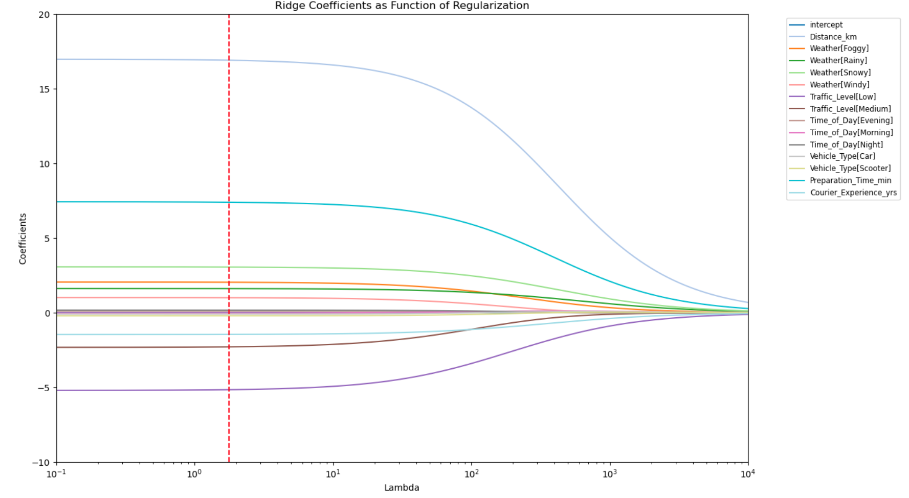
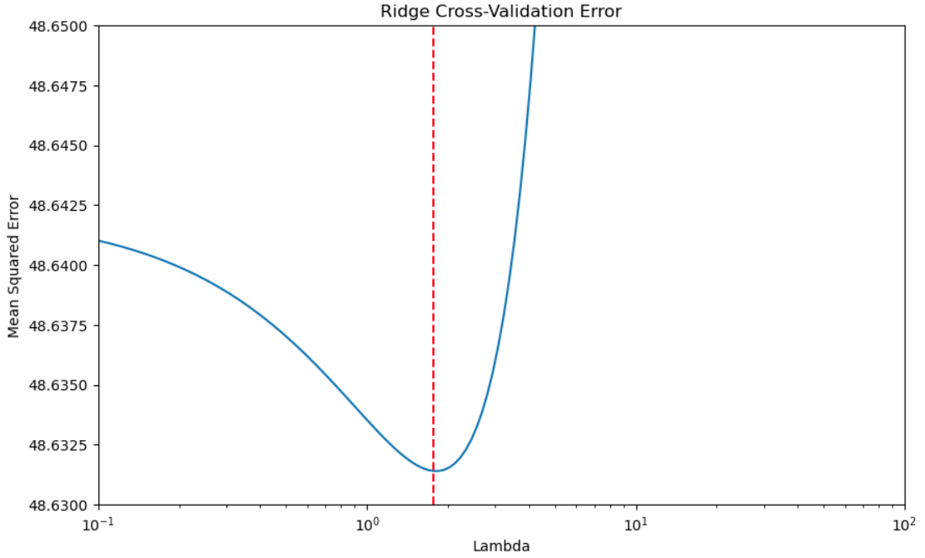
Ridge regression - graphs

Slide 22
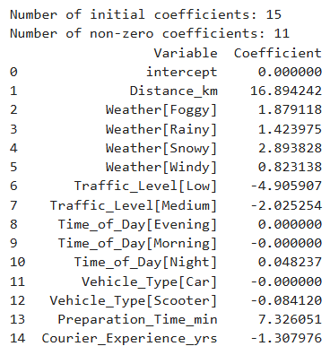
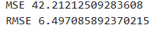
Lasso regression
We proceed in the same manner with lasso regression.
Best Lasso lambda: 0.10553861030365236
With lasso regression, the less significant variables are driven exactly to zero, allowing for model simplification. Similarly, the intercept remains zero in this case as well.
The results compared to ridge regression are practically identical.

Slide 23
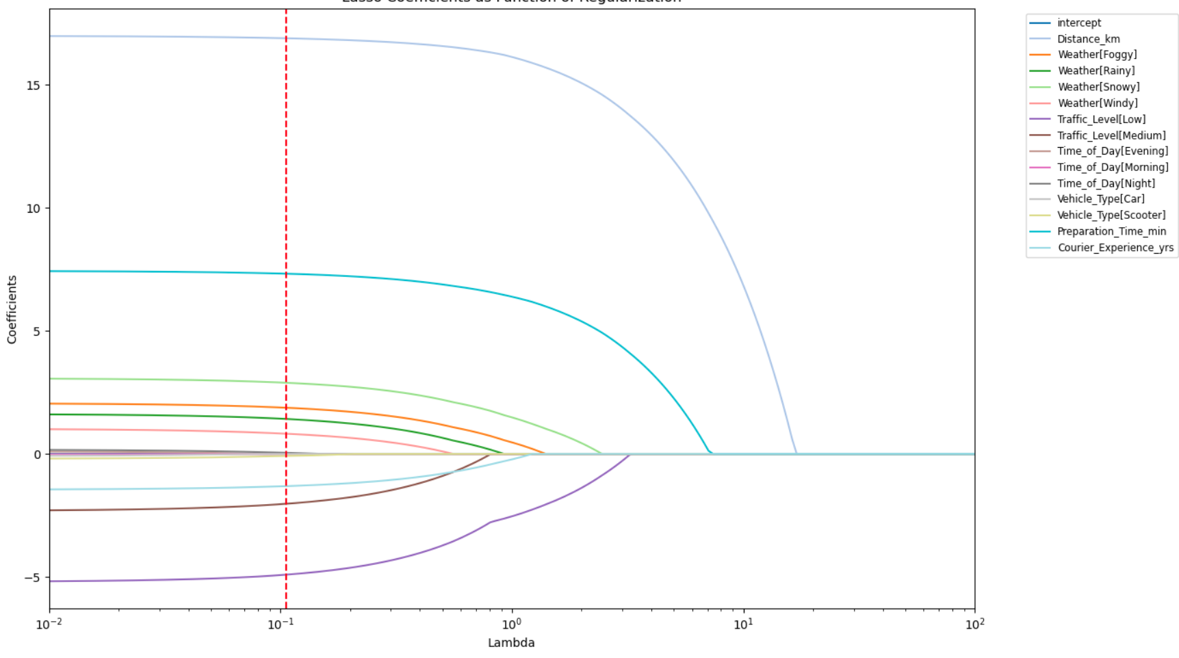
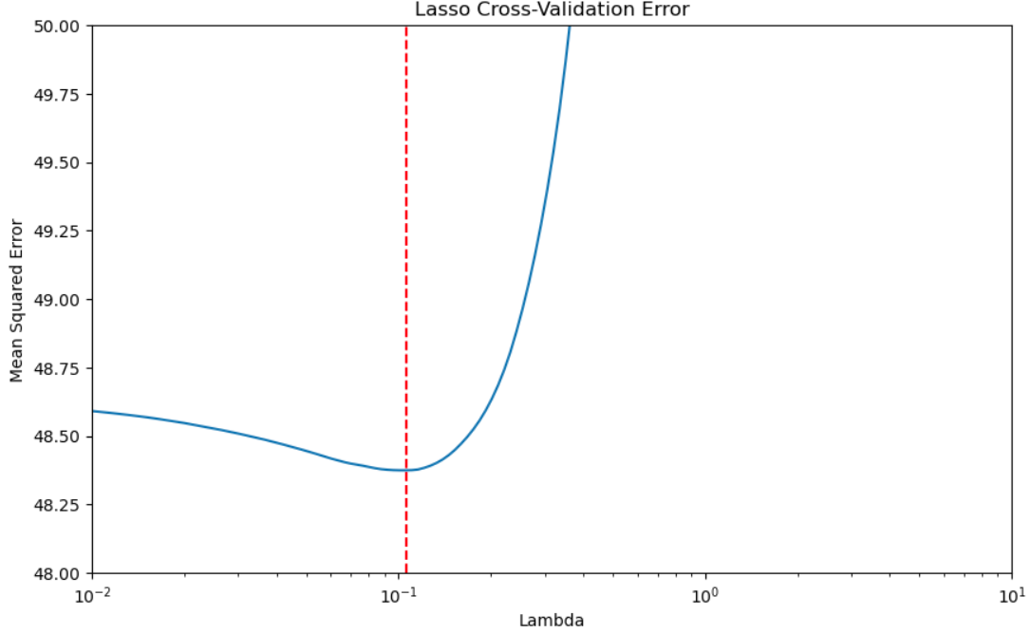
Lasso regression - graphs

Slide 24
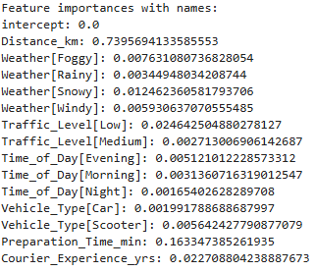
Decision trees
We now try to evaluate the dataset using decision trees, specifically regression trees (as our target variable is continuous).
We return to a non-normalized model, as normalization is not needed because tree-based methods are not sensitive to the scale of the variables.
The first resulting tree of our analysis is very complex, with 15 levels and 391 leaves, suggesting strong overfitting.
Regarding variable importance information, the results are consistent with those observed in the previous models.

Slide 25
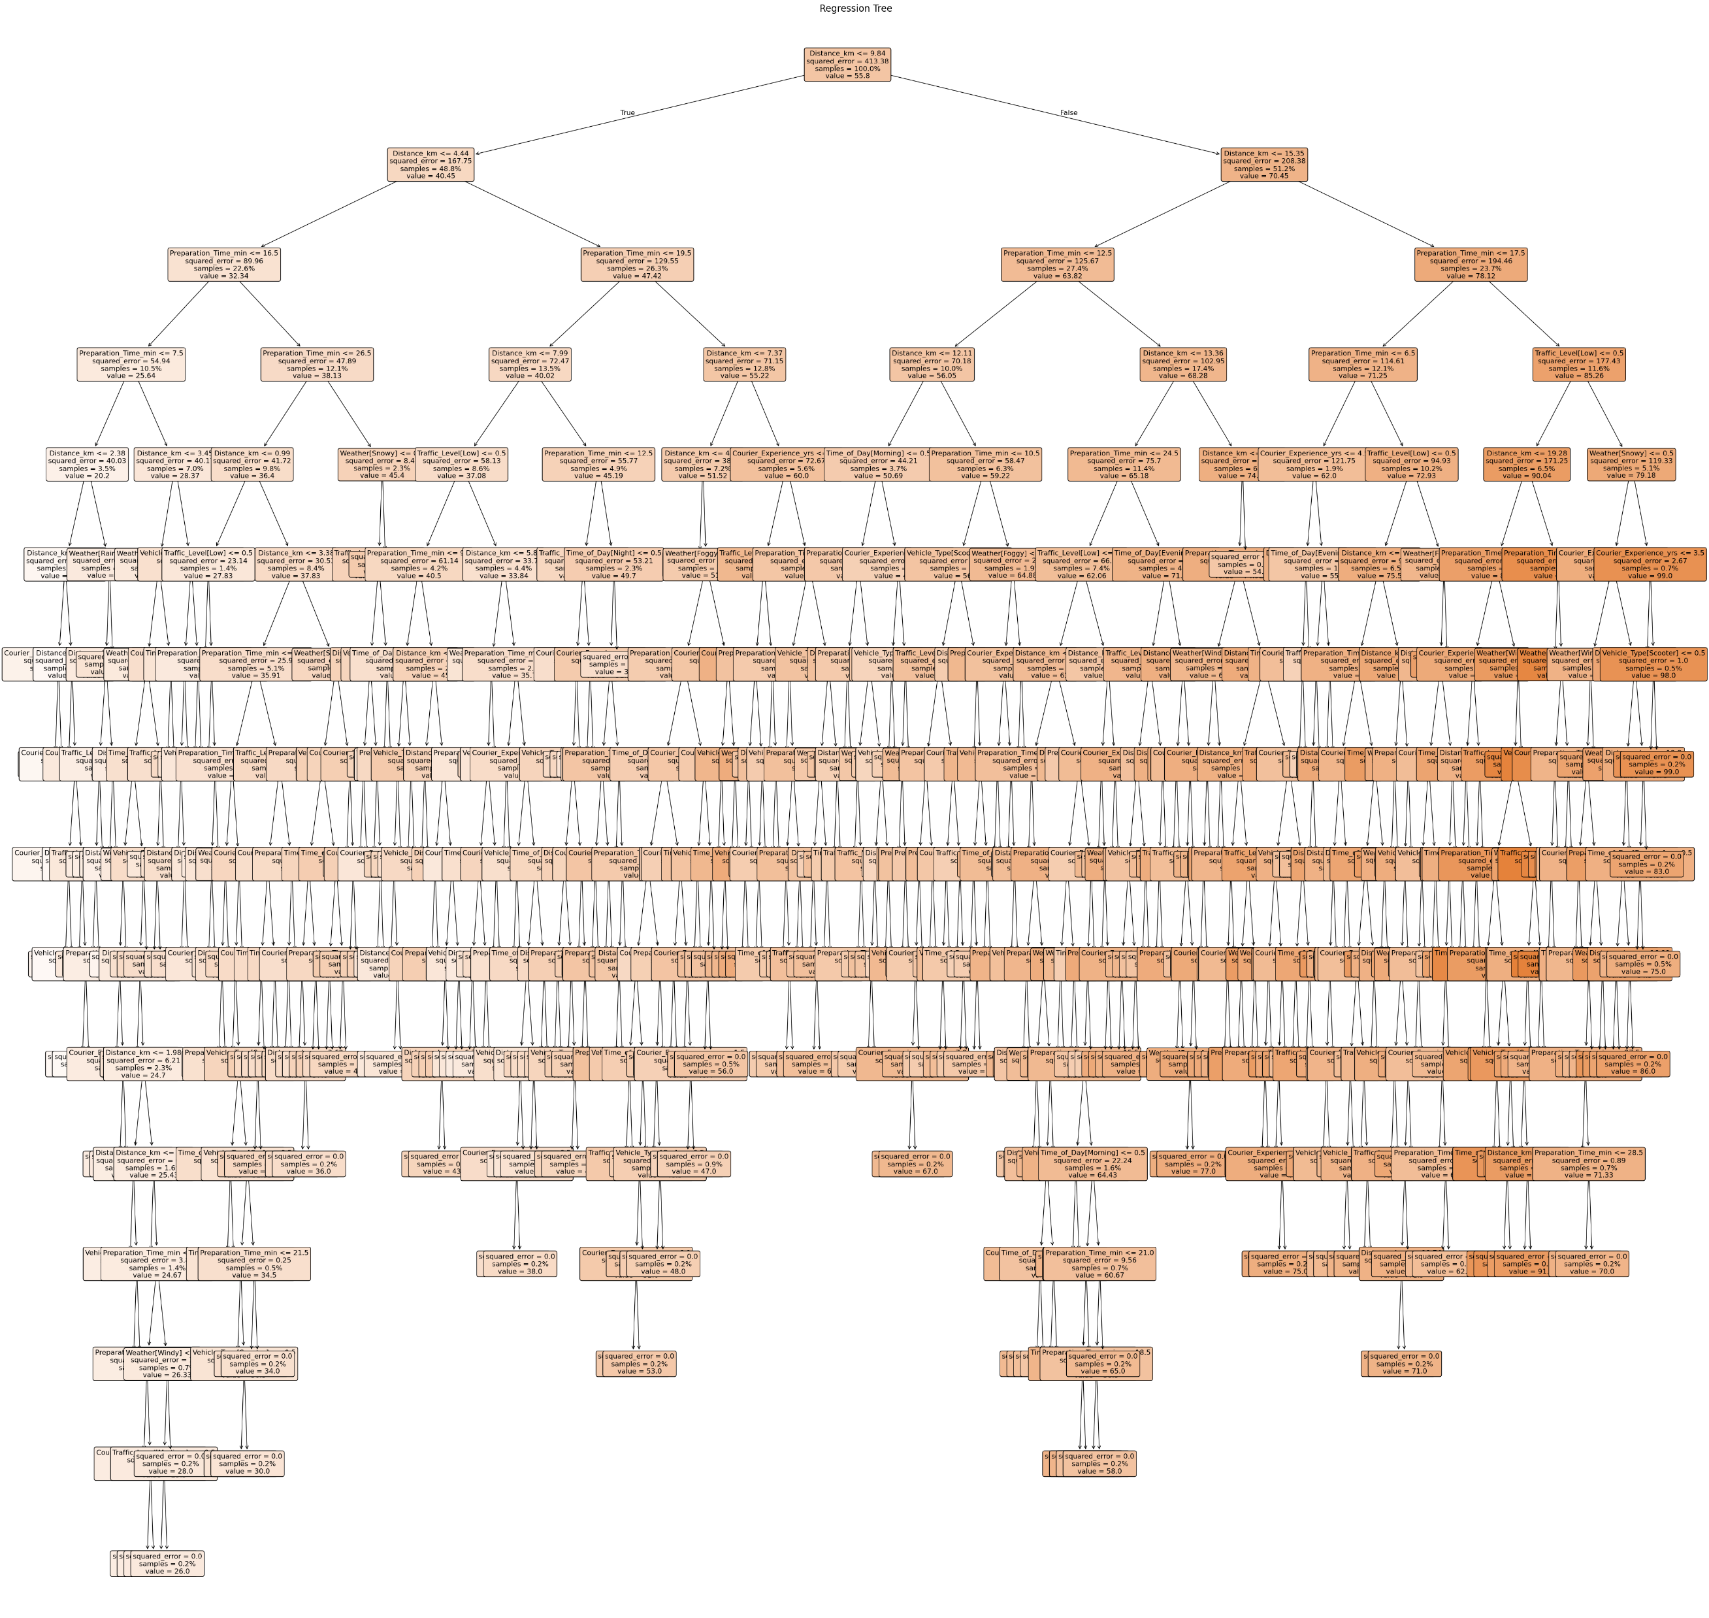
Regression tree – first attempt
The tree graph confirms the complexity of the tree, which is definetely not easily readable/ understandable.
The residual analysis also shows worse results compared to the previous models.
MAE: 8.5419
R2: 0.6977
MSE: 124.6488
RMSE: 11.1646
We proceed to optimize the tree by calculating the best depth for pruning

Slide 26
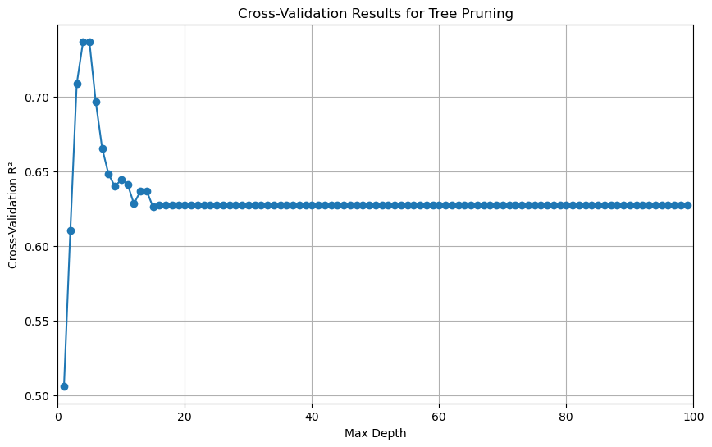
Regression tree – best depth
The graph shows the effect of the decision tree depth on performance, using cross-validation and the R² score. The results show an initial increase in R² followed by a decrease, indicating the optimization between underfitting and overfitting. The optimal depth seems to be 4, as this is where R² is maximum.

Slide 27
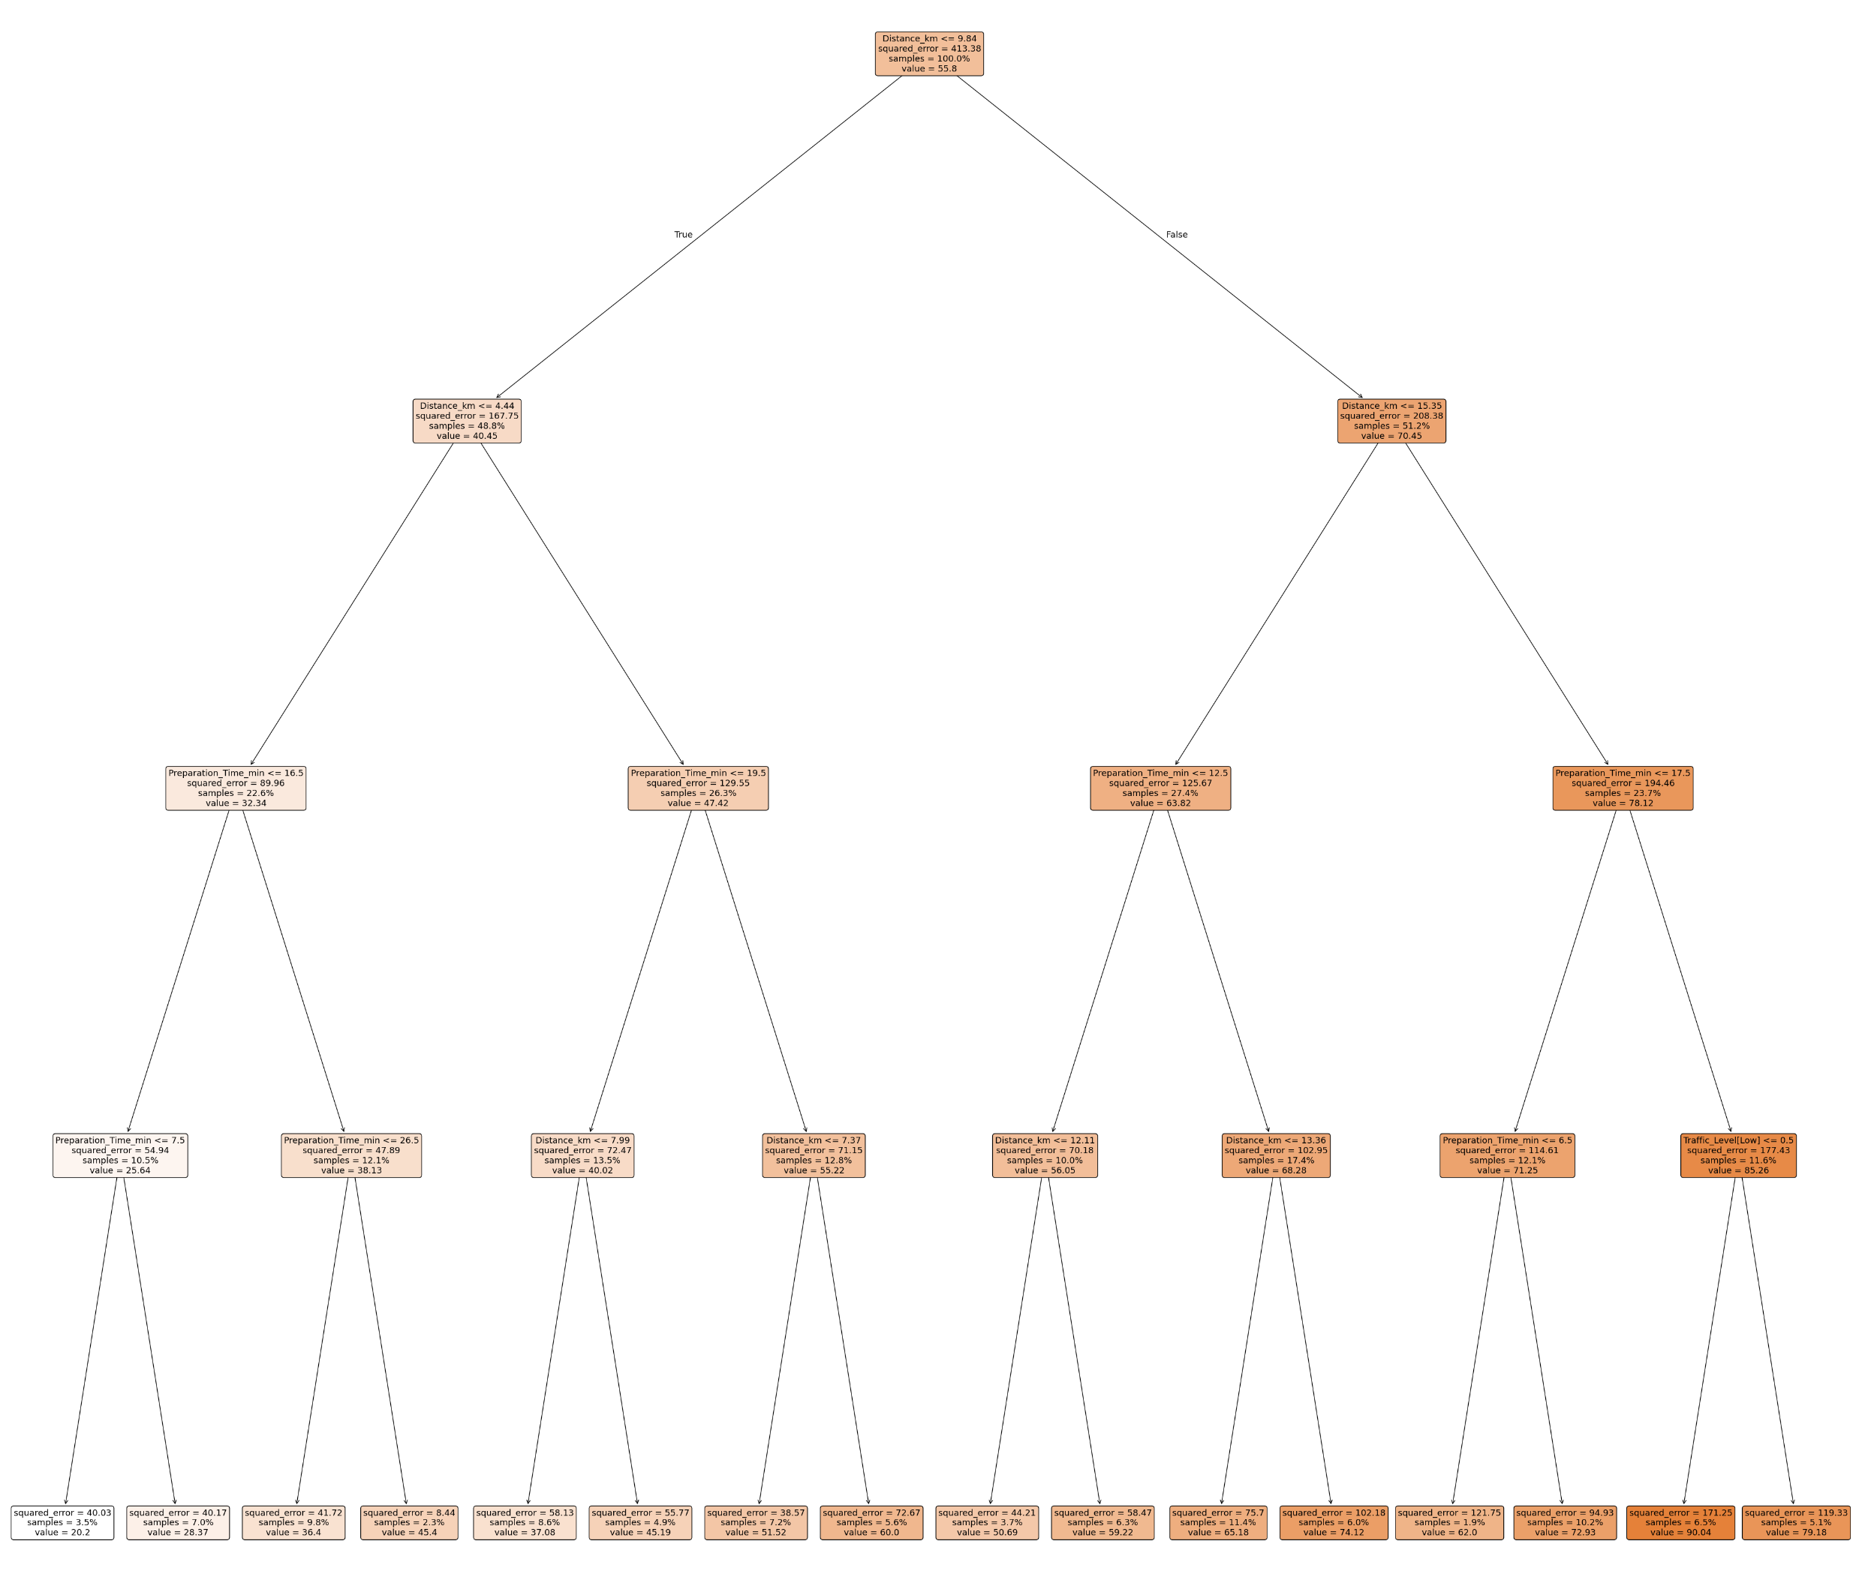
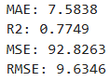
Regression tree – pruned tree
The pruned tree is much simpler and easier to explain. The only variables considered in the end are Distance_km and Preparation_Time_min. Dark orange indicate more extreme predicted values (higher or lower), while lighter or white colors indicate values close to the target mean. These do not represent categories, but rather continuous value gradations.

Slide 28
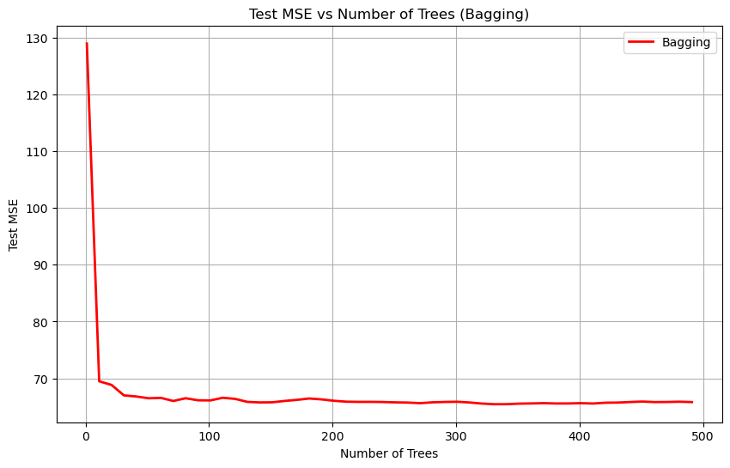
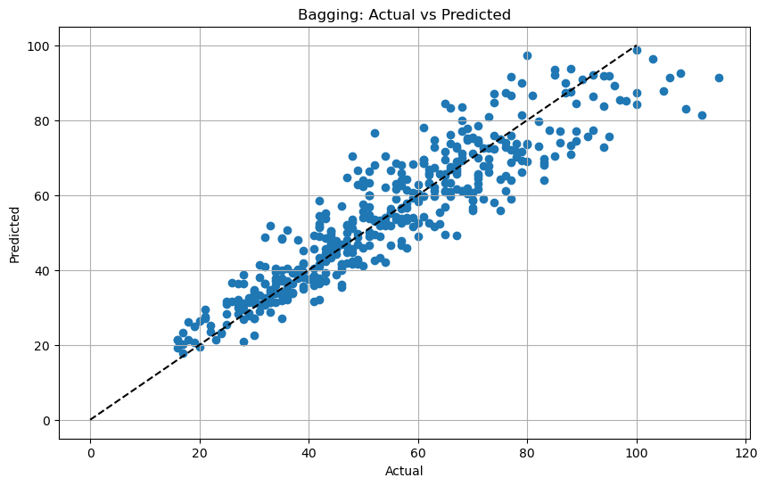
Bagging
We now try using ensemble methods for trees, starting with Bagging.
In this graph, we see that as the number of trees increases, the MSE decreases, becoming stable from around 100 trees onward.
The residual analysis shows better results compared to previous tree-based models.
Bagging MSE: 65.7354
Bagging RMSE: 8.1077
The model estimated with Bagging is accurate. It performs better than a single tree but is still worse than linear models.

Slide 29
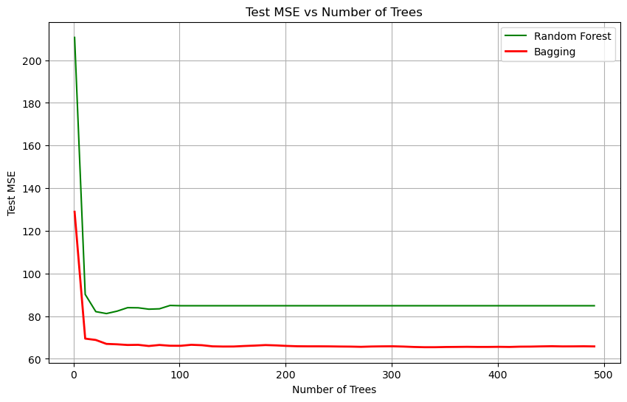
Random forest
Using Random Forest, which is an extension of Bagging, we introduce an additional layer of randomness by selecting a random subset of features at each split, rather than considering all features. This helps to reduce correlation between trees, improving the model's generalization and reducing overfitting compared to Bagging, where all features are used in each tree split.
In our case, as seen from the plot, Random Forest performs worse than Bagging. This could be due to the additional feature randomness in Random Forest, which may lead to less effective splits compared to Bagging, where all features are considered at each split.
Random Forest MSE: 84.8856
Random Forest RMSE: 9.2133

Slide 30

Boosting
As the last tree-based method, we use Boosting. Boosting is an ensemble technique that builds multiple trees sequentially, where each tree corrects the errors of the previous one.
We built our boosting model using 5000 estimators and learning rate=0.001.
Boosting MSE: 60.2433
Boosting RMSE: 7.7617
Based on the results, it appears that Boosting is the most effective tree-based method. However, it still underperforms compared to the initial linear regression models, which remain the most accurate for this dataset.

